Slide 1
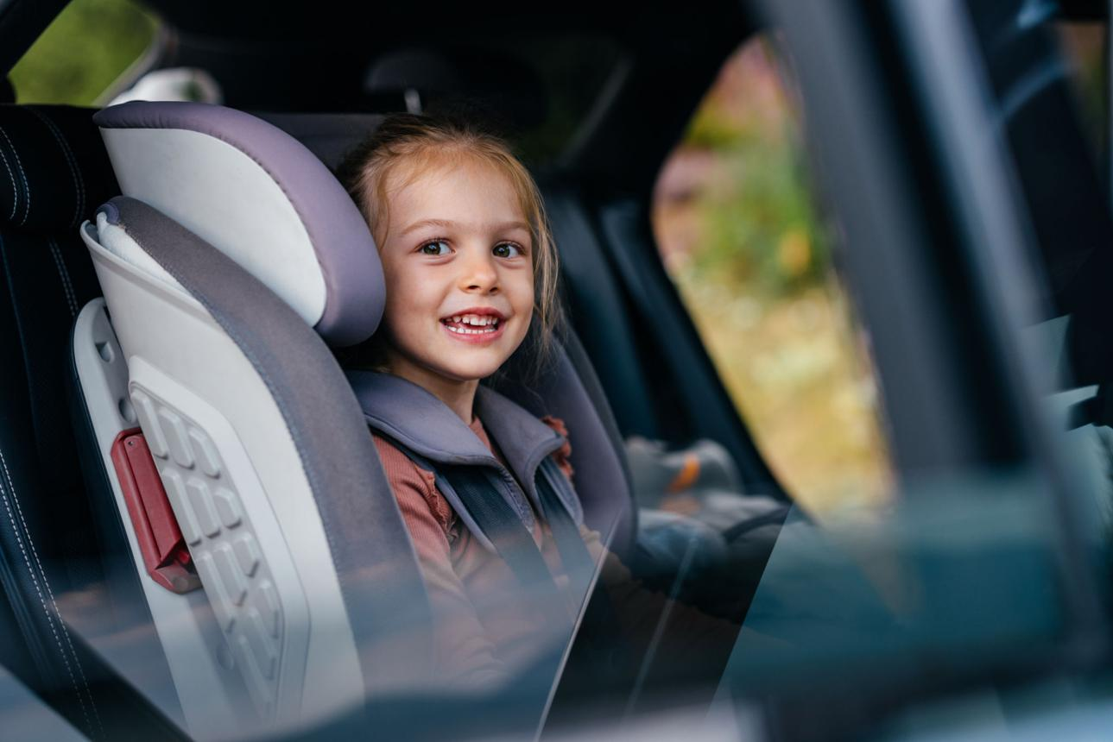
DRIVER TRAINING
WELCOME
TO DRIVER TRAINING
Safe, reliable service
You are responsible for each child

Slide 2
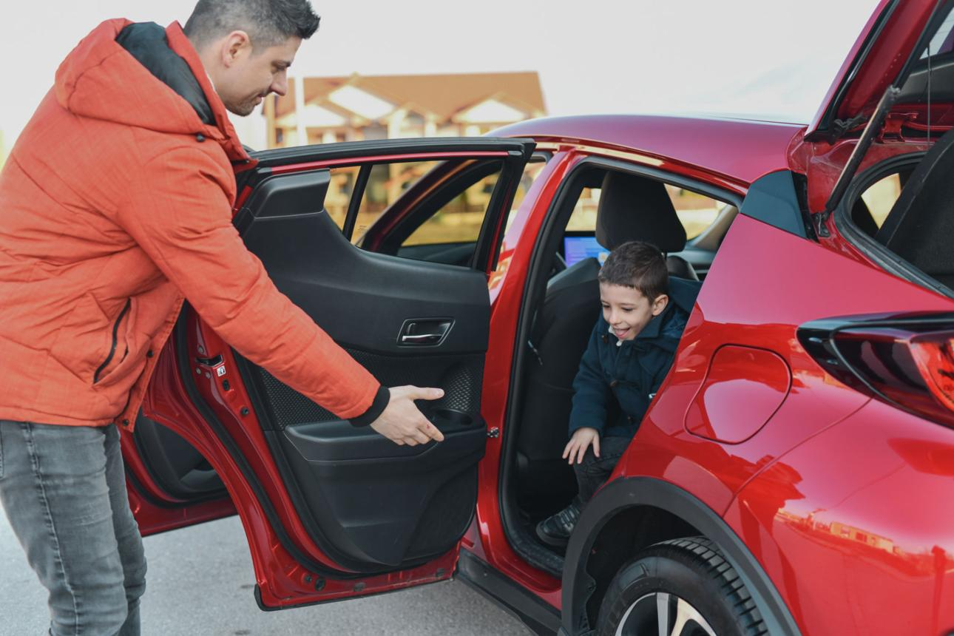
DRIVER TRAINING
YOUR ROLE
AS A DRIVER
Drive safely
Be on time
Communicate professionally

Slide 3
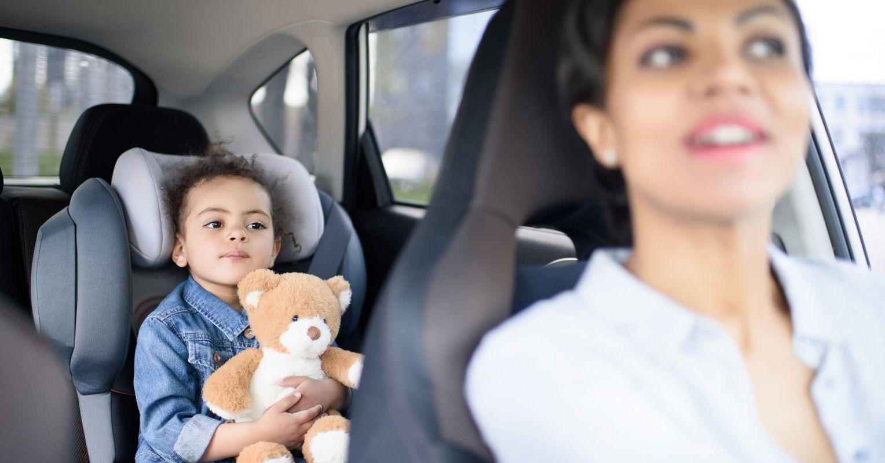
DRIVER TRAINING
UNDERSTANDING
OUR STUDENTS
Autism / ADHD
Behavior challenges
Be patient

Slide 4

DRIVER TRAINING
COMMUNICATION
WITH STUDENTS
Speak calmly
Use simple instructions
Never argue

Slide 5
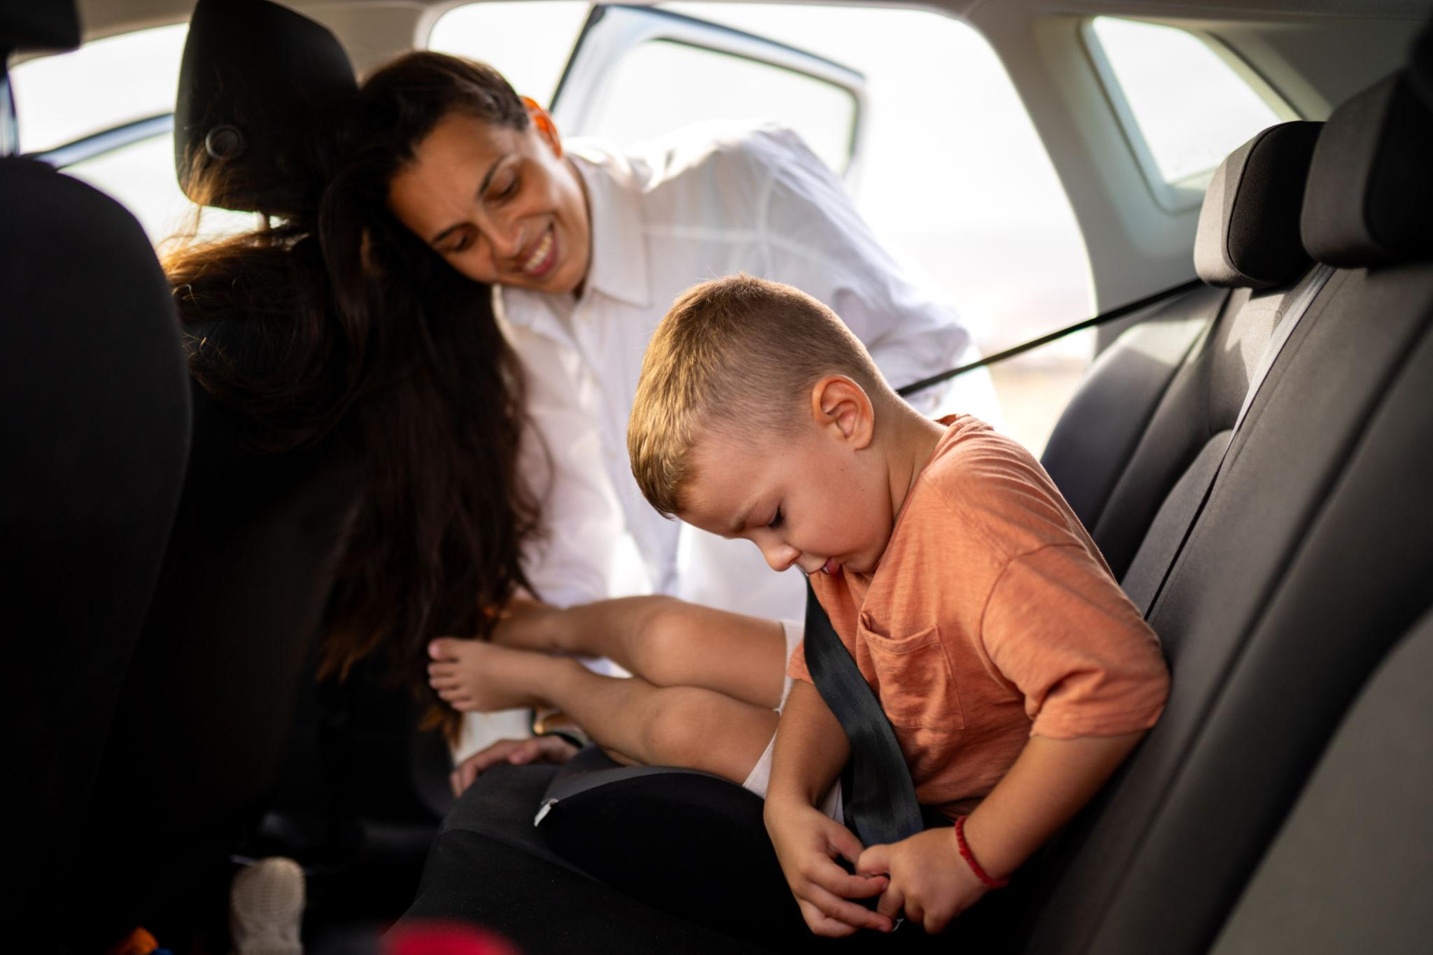
DRIVER TRAINING
HANDLING BEHAVIOR
SITUATIONS
Stay calm
Do not take personally
Pull over safely

Slide 6
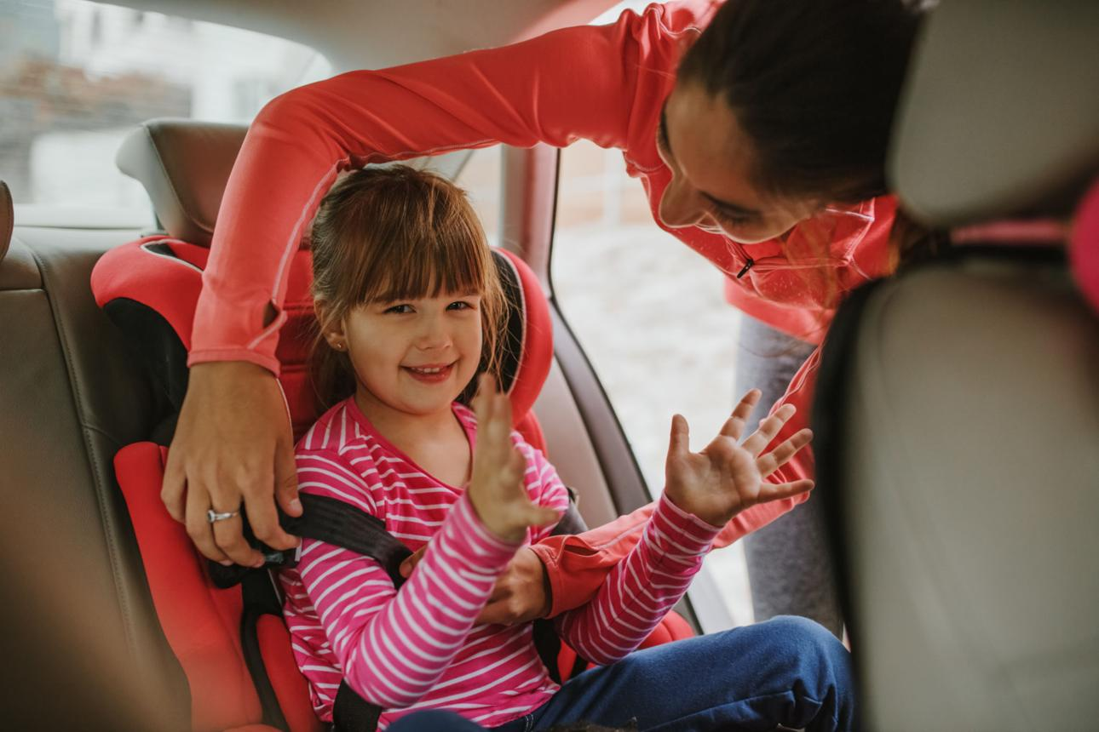
DRIVER TRAINING
SAFETY FIRST
(NON-NEGOTIABLE)
Seatbelt check
No phone use
Follow laws

Slide 7
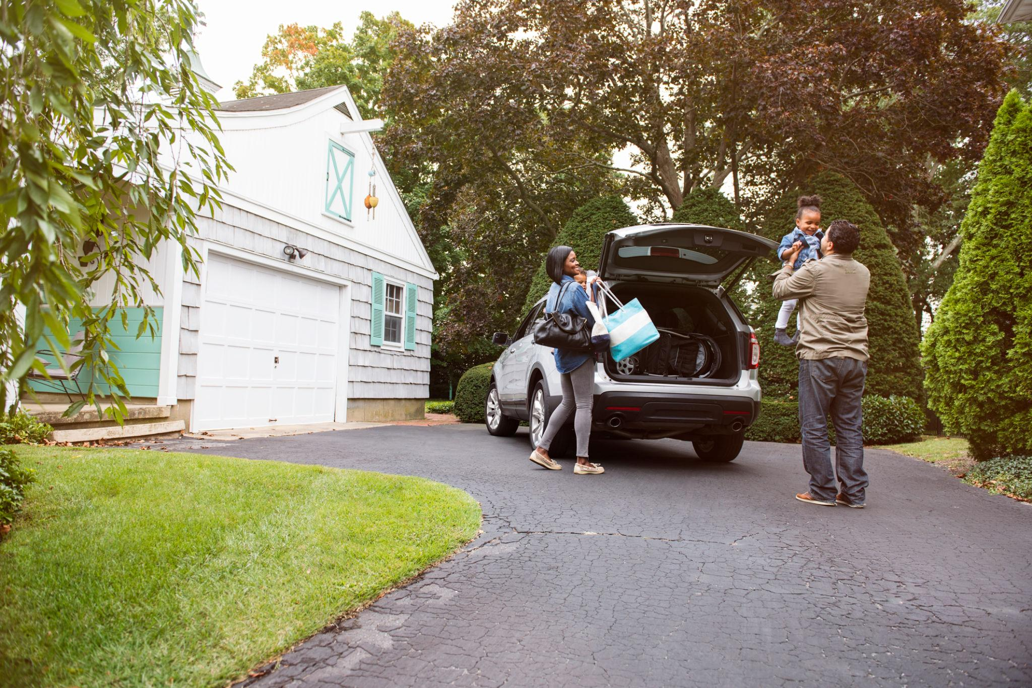
DRIVER TRAINING
PICKUP
PROCEDURE
Arrive on time
Confirm identity
Wait for guardian

Slide 8

DRIVER TRAINING
DROP-OFF
PROCEDURE
Ensure adult present
Never leave child alone

Slide 9
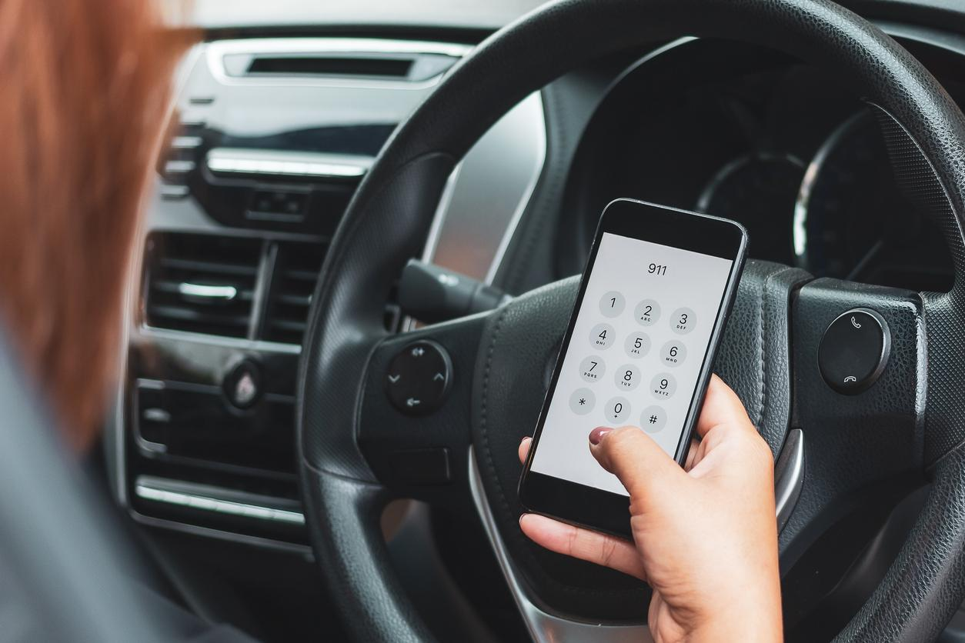
DRIVER TRAINING
EMERGENCY
SITUATIONS
Stay calm
Call 911
Report incident

Slide 10
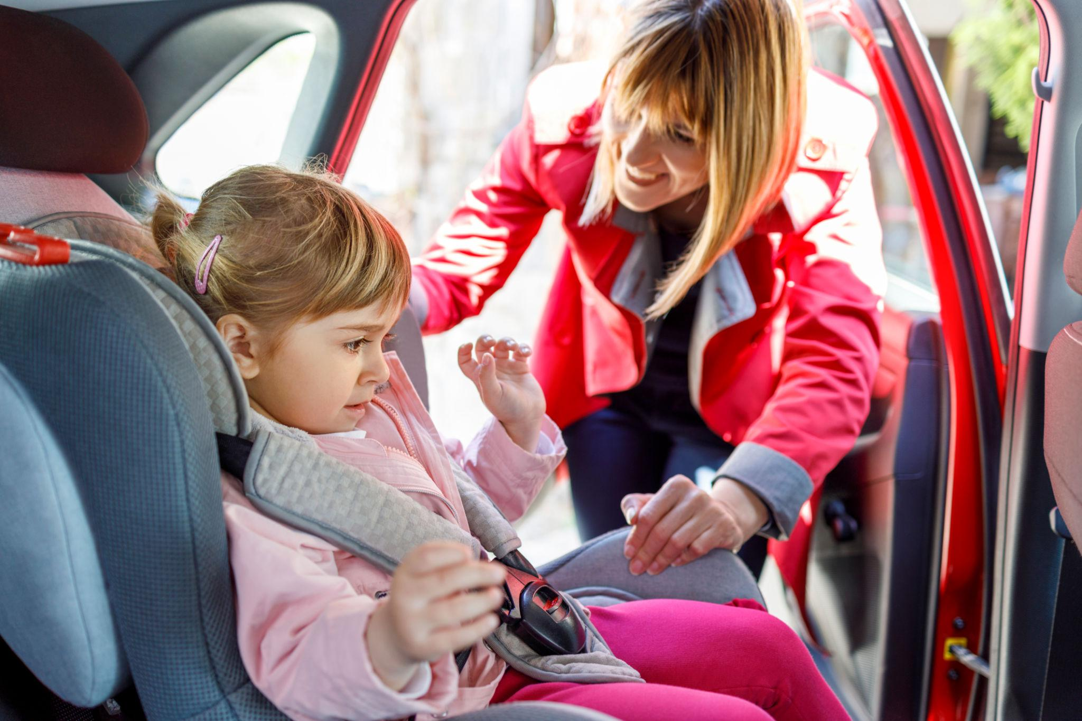
DRIVER TRAINING
SCENARIO
REFUSAL TO RIDE
Stay calm
Do not force
Call parent

Slide 11

DRIVER TRAINING
SCENARIO
STUDENT MELTDOWN
Pull over
Give space
Call support

Slide 12
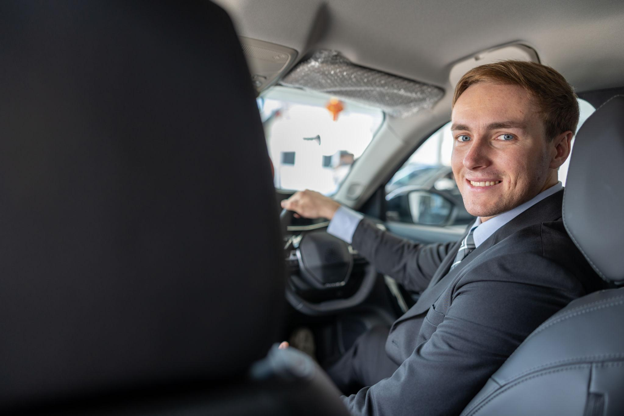
DRIVER TRAINING
PROFESSIONAL
CONDUCT
Be respectful
Maintain confidentiality
Represent company

Slide 13
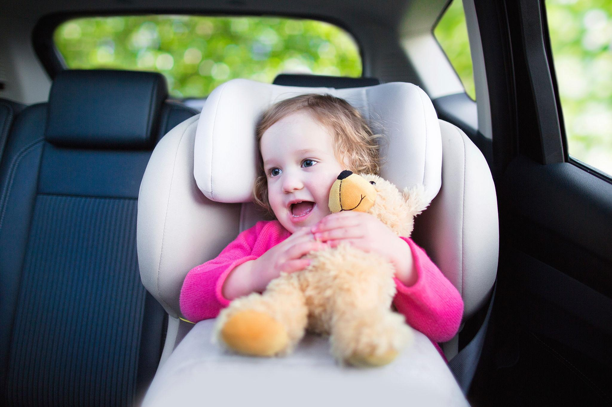
DRIVER TRAINING
FINAL
MESSAGE
Support families
Be consistent
Make a difference

